Slide 1
NCS Standards and DOE Regulations
Presented by: Dallas Moser
Nuclear Criticality Safety Engineer
Prepared by: Chris Haught
Chief NCS Engineer

Slide 2
Outline
Consensus Standards
ANS Standards on NCS, Overview
ANS Standards on NCS, Specifics
Department of Energy Regulations on NCS

Slide 3
Consensus Standards
Consensus: “An opinion or position reached by a group as a whole”
American National Standards Institute (ANSI)
  United States accrediting authority
    License or certify organizations as being able to develop American National Standards
    Private, non-profit organization
    Website: http://www.ansi.org/
Standards are comprised of consensus industry best practices
  Consensus process involves voting on the part of stakeholders
    product and/or service organizations
    users
    other interested parties (e.g. regulatory agencies)
  Very different than the process used to develop standards for government agencies such as the US Department of Energy
3

Slide 4
Consensus Standards
The hallmarks of the American National Standards process include:
    consensus on a proposed standard by a group or “consensus body” that includes representatives from materially affected and interested parties;
    broad-based public review and comment on draft standards;
    consideration of and response to comments submitted by voting members of the relevant consensus body and by public review commenters;
    incorporation of approved changes into a draft standard; and
    right to appeal by any participant that believes that due process principles were not sufficiently respected during the standards development in accordance with the ANSI-accredited procedures of the standards developer.
4
Notes:
Conformity assessment can verify that a particular product meets a given level of quality or safety.
Because conformity assessment forms a vital link between standards that de ne product characteristics or requirements and the products themselves, stakeholders in conformity assessment must better understand these conformity assessment principles to use and benefit from conformity assessment effectively.

Slide 5
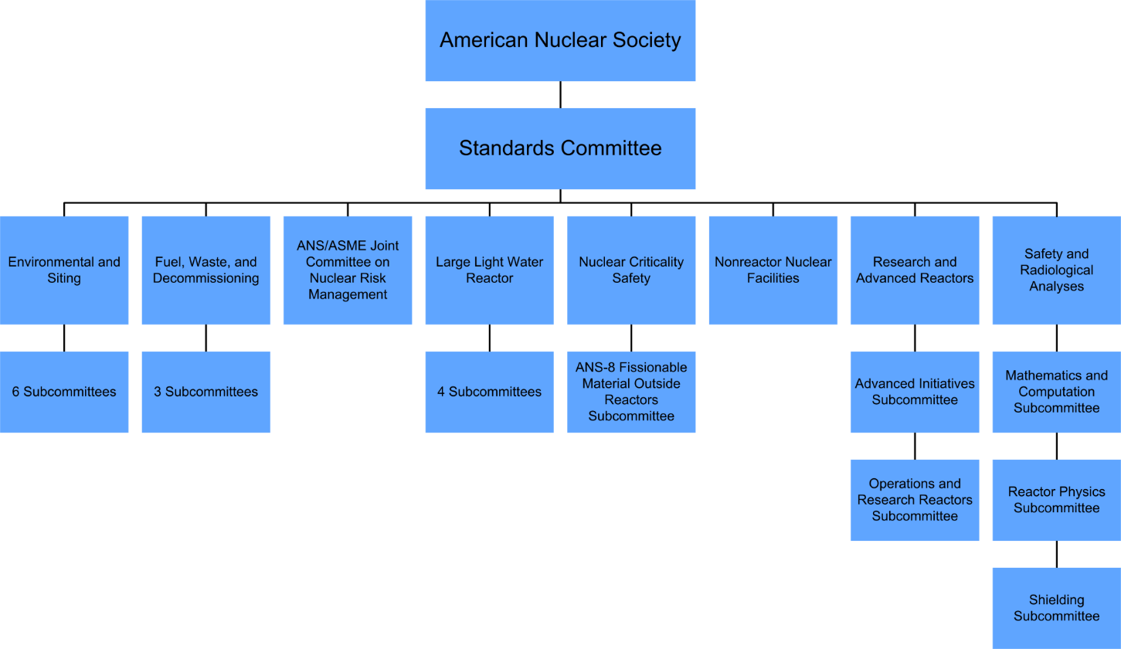
American Nuclear Society (ANS)
Professional society
  Professional Divisions
  Local sections
  Student Sections
“The American Nuclear Society (ANS) is the premier organization for those that embrace the nuclear sciences and technologies for their vital contributions to improving people’s lives and preserving the planet.”
Governance
  Board of Directors
  Executive Committee
  Committees

Slide 6

ANS Standards - Perspective
All activity involves risk (in fact, existence involves risk)
  Absolute safety can only be achieved by absence of activity
  Safety by itself has no intrinsic meaning
Safety and goals must be appropriately balanced
  Should the airline industry cease to operate to avoid accidents?
  Should you not eat in order to avoid food poisoning?
Economic considerations must also be considered
  Budgets are finite
Standards recognize these concerns
  The ANS-8 standards allow for a graded approach to safety based on facility characteristics and the risk to the public and the worker
    Ex. Per ANSI/ANS-8.10, greater criticality risk is acceptable when the workers and the public are protected from the consequences of a criticality accident by shielding (or distance) and confinement

Slide 7
ANS Standards
Standards are comprised of industry best practices
  Arrived at through a consensus agreement process
  Prescribe what programs shall and should do through requirements and recommendations
  Do not prescribe how programs are to comply with the requirements and recommendations
    Statements are purposely flexible
      Individual institutions must decide on specific implementation
Shall: denotes a requirement
Should: denotes a recommendation
May: denotes permission*
*neither a requirement nor a recommendation

Slide 8
ANS Standards
Two types of recommendations
  Practices for which compliance is explicitly demonstrable but may not always be practical, possible, or beneficial to a particular site
  Practices for which compliance is not explicitly demonstrable
The type of recommendation should be clear from the context
  Ex: Seismic Tolerance: The system should remain operational in the event of seismic shock equivalent to the site-specific design basis earthquake, or to the equivalent value specified by the Uniform Building Code that applies to the structure. (From ANSI/ANS-8.3-1997, Criticality Accident Alarm System)
  Ex: Management Responsibilities: Continuing commitment to safety should be evident. (From ANSI/ANS-8.19-2014, Administrative Practices for Nuclear Criticality Safety)

Slide 9
ANS Standards
Structure has meaning
  helps to define the relationship between statements
  statements should not be read in isolation

Slide 10
ANS Standards
Words are very carefully chosen
  convey a specific meaning
    goal is to make the meaning unambiguous
    standards provide specific definitions for terms which they believe may be subject to misinterpretation
    economy of words that is nothing short of impressive
    paraphrasing statements is difficult and a bad practice
  prudent default position
    different words=different meanings
      Ex: Credible versus possible (ANSI/ANS-8.1)
      Ex: Dependable versus reliable (ANSI/ANS-8.3)

Slide 11
ANS Standards
If in doubt as to any requirement or recommendation, an official inquiry should be made
  any doubt or misunderstanding about the textual meaning of a standard must be resolved by a direct inquiry to the ANS Standards Administrator
  A regulator may choose to impose additional conditions from ANSI standards

Slide 12
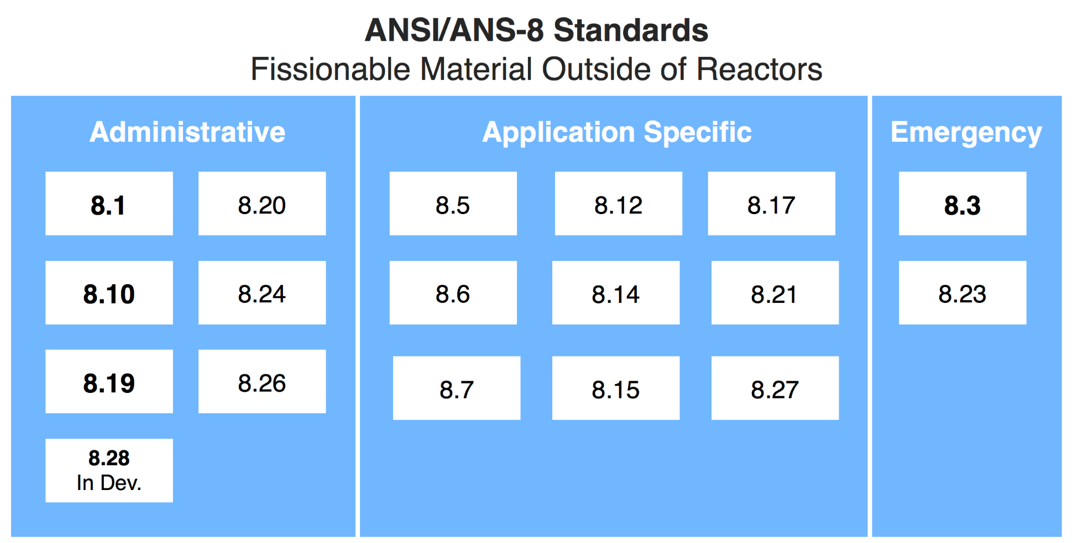
ANS Standards
Standards may be grouped into three general types

Slide 13
ANS Standards
Administrative
ANSI/ANS-8.1 | Nuclear Criticality Safety in Operations with Fissionable Material Outside of Reactors
ANSI/ANS-8.10 | Criteria For Nuclear Criticality Safety Controls in Operations with Shielding and Confinement
ANSI/ANS-8.19 | Administrative Practices For Nuclear Criticality Safety
ANSI/ANS-8.20 | Nuclear Criticality Safety Training
ANSI/ANS-8.24 | Validation of Neutron Transport Methods For Nuclear Criticality Safety Calculations
ANSI/ANS-8.26 | Criticality Safety Engineer Training and Qualification Program
ANSI/ANS-8.28 | Administrative Practices for the Use of Nondestructive Assay Measurements for Nuclear Criticality Safety

Slide 14
ANS Standards
Application
ANSI/ANS-8.5 | Use of Borosilicate-Glass Raschig Rings as a Neutron Absorber in Solutions of Fissile Material
ANSI/ANS-8.6 | Safety in Conducting Subcritical Neutron Multiplication Measurements In-Situ
ANSI/ANS-8.7 | Nuclear Criticality Safety in the Storage of Fissile Materials
ANSI/ANS-8.12 | Nuclear Criticality Control and Safety of Plutonium-Uranium Fuel Mixtures Outside of Reactors
ANSI/ANS-8.14 | Use of Soluble Neutron Absorbers in Nuclear Facilities Outside Reactors

Slide 15
ANS Standards
Application
ANSI/ANS-8.15 | Nuclear Criticality Safety Control of Selected Actinide Nuclides
ANSI/ANS-8.17 | Criticality Safety Criteria For the Handling, Storage, and Transportation of LWR Fuel Outside of Reactors
ANSI/ANS-8.21 | Use of Fixed Neutron Absorbers in Nuclear Facilities Outside of Reactors
ANSI/ANS-8.22 | Nuclear Criticality Safety Based on Limiting and Controlling Moderators
ANSI/ANS-8.27 | Burnup Credit for LWR Fuel

Slide 16
ANS Standards
These are covered in detail in the lecture on Emergency Preparedness
Emergency Response
ANSI/ANS-8.3 | Criticality Accident Alarm System
ANSI/ANS-8.23 | Nuclear Criticality Accident Emergency Planning and Response

Slide 17
ANS Standards
Nuclear Criticality Safety is personnel protection from the consequences of a criticality accident, preferably by prevention of the accident
The ANS-8 standards are applicable to personnel protection (and the public)
  A few example statements from the ANS-8 standards:
    Good safety practices should recognize economic consideration, but the protection of operating personnel and the public must be the dominant consideration (ANS-8.1, Section 1)
    Distinction may be made between shielded and unshielded facilities, and the criteria may be less stringent when adequate shielding and confinement assure the protection of personnel (ANS-8.1, Section 4.1.1)
    The purpose of an alarm system is to reduce risk to personnel (ANS-8.3, Section 4.1.1)
    …if adequate shielding against radiation and confinement of radioactive materials are provided, the risks normally attendant with a criticality accident in a facility lacking shielding and confinement are reduced. (ANS-8.10, Section 1)

Slide 18
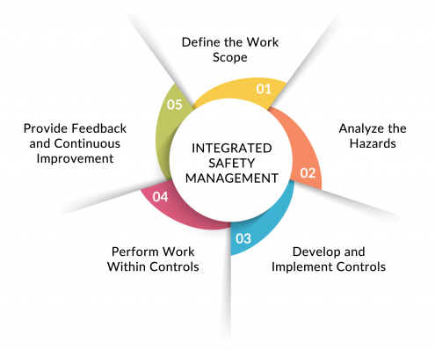

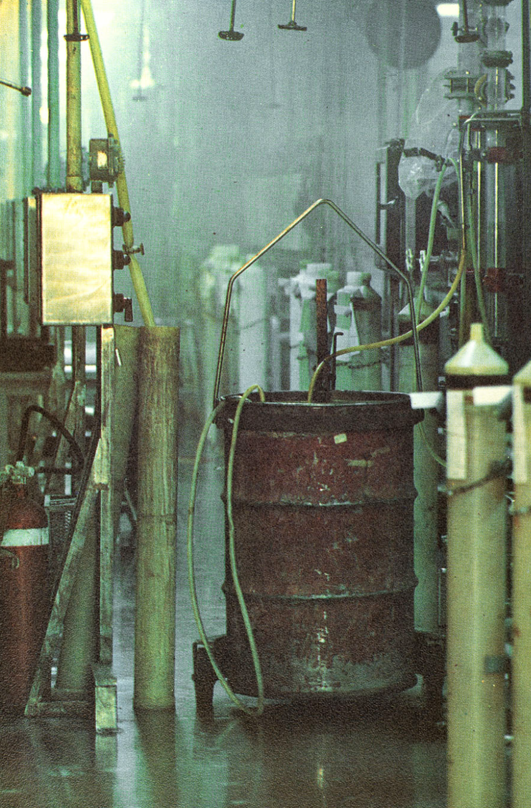
ANS Standards
ANS-8 standards encompass all aspects of the operating environment
  Healthy safety culture
    “Refers to the attitudes, beliefs, and perceptions shared by natural groups as defining norms and values, which determine how they act and react in relation to risks and risk control systems. (safety culture)” [Hale, 2000]
      From the top levels of management to the those performing the work
  Formality of Operations Program
    Procedures, training, engineering, maintenance, & configuration management
    Provide mechanisms for the implementation of NCS controls
  NCS Program improvement opportunities
    Lessons learned, Infraction response, assessments & reviews
  Criticality detection and emergency response
AKA Conduct of Operations

Slide 19
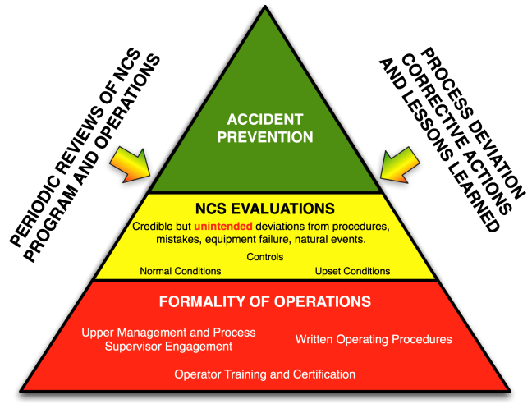
Dependencies
The “NCS pyramid”
  Shows how a site’s overall FOP is the foundation of a strong NCS program
  Indicates that periodic reviews of an NCS program and fissionable material operations at a site and serious consideration of process deviation corrective actions and lessons-learned are ways to significantly improve a site’s NCS program.

Slide 20
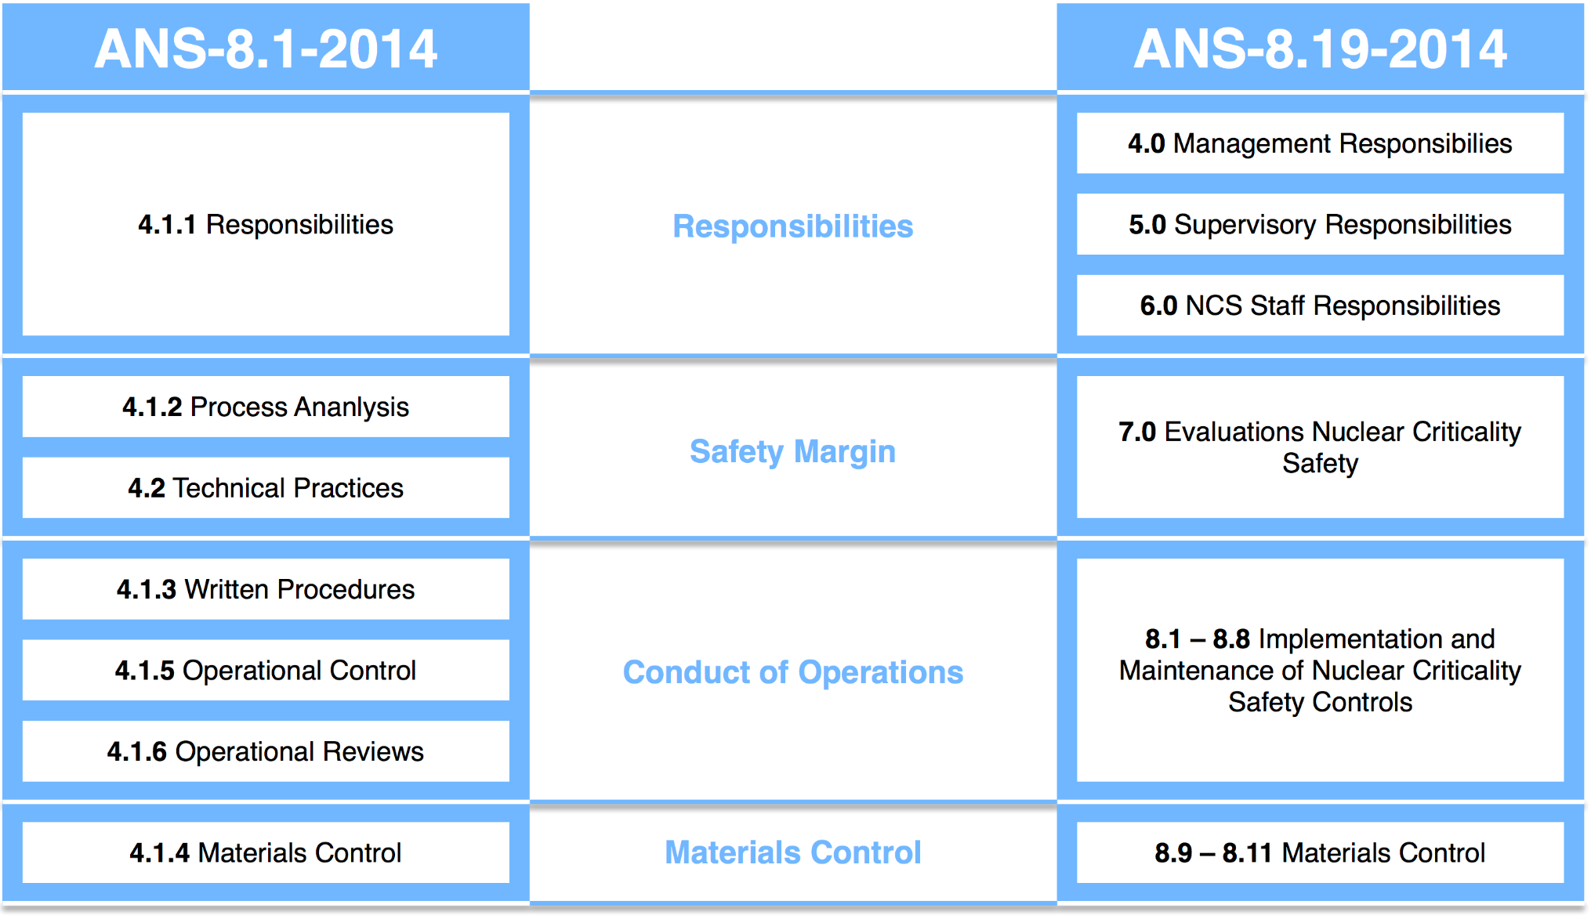
ANS Standards
Structures of ANS-8.1 and ANS-8.19
NCS Evaluations

Slide 21
ANSI/ANS 8.1 and 8.19
Management with NCS responsibilities shall:
Accept overall responsibility for safety of operation
  Continuing commitment to safety should be evident
Formulate NCS policy and make it known to all personnel involved in operations with fissile material
Assign responsibility and delegate commensurate authority to implement the established NCS policy (consistent with other safety programs)
  Everyone, regardless of position, shall be made aware that NCS in their work area is their responsibility
  This may be accomplished through training and periodic retraining of all operating and support personnel per ANSI/ANS-8.20
Provide personnel familiar with the physics of NCS and with associated safety practices to furnish technical guidance appropriate to the scope of operations.
  Function should, to the extent practicable, be administratively independent of operations

Slide 22
ANSI/ANS 8.1 and 8.19
Management with NCS responsibilities shall (site management)
Establish a training and qualification program for NCS staff per ANS-8.26
Establish a method of monitoring the NCS program
Participate in periodically auditing the NCS program
Establish and maintain a configuration management system that identifies, and controls changes to facilities, equipment and processes important to NCS
Establish a process for developing, reviewing, supplementing, and revising operating procedures
Establish the criteria to be satisfied by NCS controls
  Criteria may be less stringent when adequate shielding and confinement assure the protection of personnel – ANS-8.10 (shielding/confinement)
Use consultants and NCS committees to achieve NCS program objectives
Management with NCS responsibilities may

Slide 23
ANSI/ANS 8.1 and 8.19
Supervisors with NCS responsibilities:
…should be made as responsible for NCS as they are for production, development, research, or other functions
…shall accept responsibility for the safety of operations under their control
…shall be knowledgeable in those aspects of NCS relevant to operations under their control.
  Training and assistance should be obtained from the NCS staff
…shall ensure that NCS training is provided to the personnel under their supervision (ANS-8.20)
… shall develop or participate in the development of procedures applicable to the operations under their control
  Maintenance of these procedures to reflect changes in operations shall be a continuing supervisory responsibility

Slide 24
ANSI/ANS 8.1 and 8.19
Supervisors with NCS responsibilities:
…shall verify compliance with NCS specifications for new or modified equipment before its use
  Verification may be based on inspection reports or other features of the quality assurance program
…shall be responsible for the inspection, testing, and maintenance of engineered controls
…shall require conformance with good safety practices, including unambiguous identification of fissile materials and good housekeeping
…may obtain assistance from fulfilling the responsibilities [training, maintenance, equipment] from other functions, such as facility operations and maintenance.

Slide 25
ANSI/ANS 8.1 and 8.19
NCS Staff:
…shall provide technical guidance for the design of equipment and processes and for the development of operating procedures
…shall maintain familiarity with current developments in NCS standards and guides.
  Knowledge of NCS information should be maintained
…should consult with knowledgeable individuals to obtain technical assistance as needed
…shall maintain familiarity with all operations within the organization requiring NCS controls.
  This shall be accomplished by individual staff members maintaining familiarity with operations for which they provide guidance
…shall assist supervision, on request, in training personnel

Slide 26
ANSI/ANS 8.1 and 8.19
NCS Staff:
…shall conduct or participate in audits of NCS practices, including compliance with procedures, as directed by management
…shall examine reports of procedural violations and other deficiencies for possible improvement of safety practices and procedural requirements
  Findings shall be reported to management
…should periodically review NCS evaluations to determine their continued applicability and validity.
  This should include review of elements of the evaluation such as scope, assumptions, normal and credible abnormal conditions, controls and limits
Observations
  There are no specific NCS staff responsibilities in ANSI/ANS-8.1. All are dedicated to upper management and process supervisors.
  The structure and language in ANSI/ANS-8.19 suggest a hierarchy where Management and Supervision have ultimate responsibility for NCS and the NCS Staff is placed in an advisory role

Slide 27
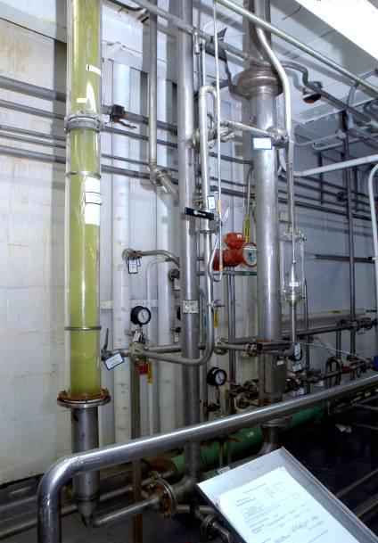
ANSI/ANS 8.1 and 8.19
NCS Evaluations:
To be covered in later lectures
Operations for which criticality safety is pertinent shall be governed by written procedures
  Exist to facilitate and document the safe and efficient conduct of operations
The procedures shall
  include NCS controls and limits
  be periodically reviewed by supervision
  be reviewed by NCS advisors
Procedures should be
  organized for convenient use by operators
  conveniently available to operators
  free of extraneous materials
  such that no single, inadvertent departure can cause a criticality accident
Procedures:

Slide 28

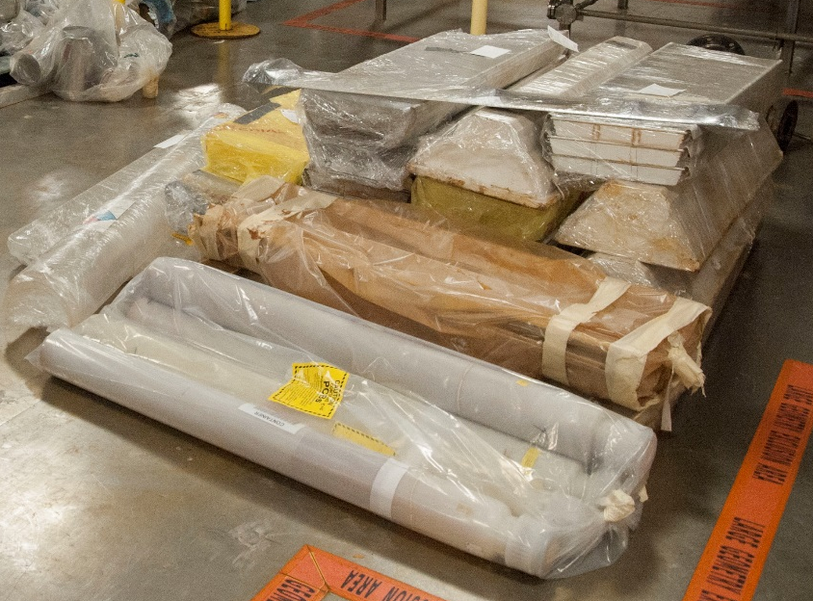
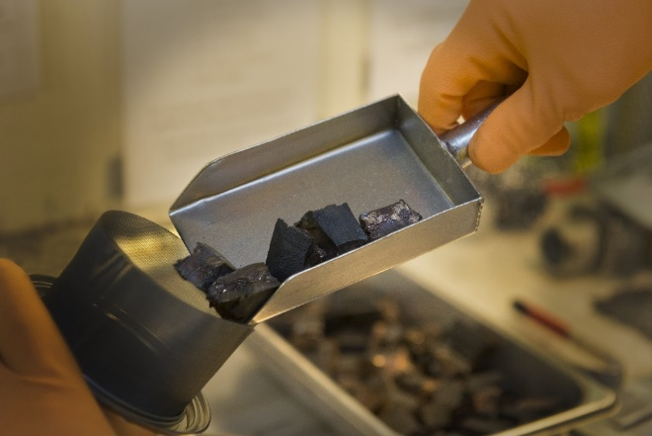
ANSI/ANS 8.1 and 8.19
Materials Control:
Control fissionable material movement by written procedures
Label containers/materials
  information important to control implementation
Supplement procedures with posting
  information important to control implementation
Control access to fissionable material handling areas

Slide 29
ANSI/ANS-8 Standards with Subcritical Limits
ANSI/ANS-8.1 – NCS In Operations with Fissionable Materials Outside Reactors
Single parameter subcritical limits
Uniform aqueous solutions – ²³³UO₂F₂, ²³³UO₂(NO₃)₂, ²³⁵UO₂F₂, ²³⁵UO₂(NO₃)₂, ²³⁹Pu(NO₃)₄
²³⁵U enrichment – uranium homogeneously in water
Metal units – ²³³U, ²³⁵U, and ²³⁹Pu
Oxides (≤1.5 w/o water) – ²³³UO₂, ²³³U₃O₈, ²³³UO₃, ²³⁵UO₂, ²³⁵U₃O₈, ²³⁵UO₃, ²³⁹PuO₂

Slide 30
ANSI/ANS-8 Standards with Subcritical Limits
ANSI/ANS-8.1 – NCS In Operations with Fissionable Materials Outside Reactors
Multiparameter subcritical limits
Uranium-water lattices
    Mass, cylinder diameter, slab thickness, volume, & areal density
  Aqueous solutions of low-enriched uranium
    Mass, cylinder diameter, slab thickness, volume, & concentration
  Aqueous solutions of Pu(NO₃)₄ containing ²⁴⁰Pu
    Mass, cylinder diameter, slab thickness, volume, & concentration , H/Pu, & areal density

Slide 31
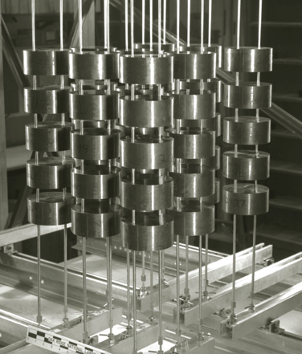
ANSI/ANS-8 Standards with Subcritical Limits
ANSI/ANS-8.7 – NCS in the Storage of Fissile Materials
Unit mass limits (kg) per storage cell in water-reflected storage arrays
²³⁵U systems
  Metal, H/U ≤ 0.01; U(100) & U(93.2)
  Oxides, H/U ≤ 0.4-20; 30-93.2 wt. % ²³⁵U
²³⁹Pu systems
  Metal, H/Pu ≤ 0.01; Pu(0) & Pu(20)
  Oxides, H/Pu ≤ 0.4-20; Pu(0) & Pu(20)
²³³U systems
  Metal, H/U ≤ 0.01
  Oxides, H/U ≤ 0.4

Slide 32
ANSI/ANS-8 Standards with Subcritical Limits
ANSI/ANS-8.12 – Nuclear Criticality Control and Safety of Pu-U Fuel Mixtures Outside Reactors
Subcritical limits
Uniform aqueous mixtures of Pu oxide and natural uranium (3-30 wt. % mixtures of PuO₂ in PuO₂+UO₂
  ²⁴⁰Pu > ²⁴¹Pu; ²⁴⁰Pu ≥ 15 wt. % & ²⁴¹Pu ≤ 6 wt. %; ²⁴⁰Pu ≥ 25 wt. % & ²⁴¹Pu ≤ 15 wt. %
  Mass of Pu in oxide mixture; mass of PuO₂+UO₂, cylinder diameter, slab thickness, Pu conc., PuO₂+UO₂ conc., H/Pu, areal density of Pu, areal density of PuO₂+UO₂
    Single units of homogeneously mixed oxides of Pu and Nat. U at low moderation
  Dry & damp mixed oxides (PuO₂+UO₂) at theoretical density
  Damp mixed oxides (PuO₂+UO₂) with 50% voids

Slide 33
ANSI/ANS-8 Standards with Subcritical Limits
ANSI/ANS-8.12 – Nuclear Criticality Control and Safety of Pu-U Fuel Mixtures Outside Reactors
Subcritical limits
    Concentration limits for Pu in homogeneous mixtures of Pu and Nat. U of unlimited mass
  PuO₂ in PuO₂+UO₂
  Pu(NO₃)₄ in Pu(NO₃)₄+UO₂(NO₃)₂
    Homogeneous and heterogeneous mixtures of the oxides of Pu and Nat. U in water as a function of the PuO₂ content
  Limiting mass, volume, cylinder dia., slab thickness, & areal density (curves)

Slide 34
ANSI/ANS-8 Standards with Subcritical Limits
ANSI/ANS-8.15 – Nuclear Criticality Safety Control of Selected Actinide Nuclides
Subcritical limits
Unreflected, water-reflected, and steel-reflected spherical metal systems
  ²³²U, ²³⁴U, ²³⁷Np, ²³⁶Pu, ²³⁸Pu, ²⁴⁰Pu, ²⁴¹Pu, ²⁴²Pu, ²⁴¹Am, ^{242m}Am, ²⁴³Am, ²⁴²Cm, ²⁴³Cm, ²⁴⁴Cm, ²⁴⁵Cm, ²⁴⁶Cm, ²⁴⁷Cm, ²⁴⁹Cf, ²⁵¹Cf
    Unreflected, water-reflected, and steel-reflected spherical metal-water mixtures
  ²³⁶Pu, ²⁴¹Pu, ^{242m}Am, ²⁴³Cm, ²⁴⁵Cm, ²⁴⁷Cm, ²⁴⁹Cf, ²⁴¹Cf
    Concentration limits and corresponding atomic ratios for homogeneous metal-water mixtures
  ²³²U, ²³⁴U, ²³⁷Np, ²³⁶Pu, ²³⁸Pu, ²⁴⁰Pu, ²⁴¹Pu, ²⁴²Pu, ²⁴¹Am, ^{242m}Am, ²⁴³Am, ²⁴²Cm, ²⁴³Cm, ²⁴⁴Cm, ²⁴⁵Cm, ²⁴⁶Cm, ²⁴⁷Cm, ²⁴⁹Cf, ²⁵¹Cf
    Mass limits for selected oxides
  ²³⁷NpO₂, ²³⁸PuO₂, ²⁴⁰PuO₂, ²⁴¹AmO₂, ²⁴³AmO₂, ²⁴⁴Cm₂O₃, ²⁴⁴CmO₂

Slide 35
ANSI/ANS-8 Standards with Subcritical Limits
ANSI/ANS-8.15 – Nuclear Criticality Safety Control of Selected Actinide Nuclides
Subcritical limits
    Appendix A – Subcritical mass limits for isotopic mixtures of Pu, Am, and Cm
    Appendix B – Physical characteristics of special actinide elements
    Appendix C – Bases for the subcritical limits
    Appendix D – Recommended bibliography

Slide 36


Federal Regulations in DOE Facilities
National Technology Transfer and Advancement Act of 1995 (USC 272)
Code of Federal Regulations (10 CFR 830)
DOE Order 420.1 C, Facility Safety
Notes:
Note that there are numerous other federal regulations that apply to DOE facilities – this is only showing how NCS requirements are promulgated.
Public Law 104-113, National Technology Transfer and Advancement Act of 1995, 15 USC 272

Slide 37
Federal Regulations in DOE Facilities
National Technology Transfer and Advancement Act of 1995
  Recognizes the importance of consensus standards
  Case law indicates organizations can be held liable if injury occurs and an available consensus standard was not being followed
  Requires government agencies to follow consensus standards where available
Section 830.204(b)(6) of 10 CFR Part 830 specifies the requirement with respect to a nonreactor nuclear facility
  Ensures that operations with fissionable material remain subcritical under all normal and credible abnormal conditions
  Identifies applicable nuclear criticality safety standards, and
  Describes how the program meets applicable nuclear criticality safety standards.

Slide 38
Federal Regulations in DOE Facilities
DOE Order 420.1C, Facility Safety
  Attachment 2, Chapter III, Nuclear Criticality Safety

Slide 39
Federal Regulations in DOE Facilities
Requirements (paraphrased)
  A program document shall be developed and maintained to describes how the contractor meets the NCS requirements in this chapter
  The program document shall describe how the contractor will satisfy the requirements of the ANSI/ANS-8 series of nuclear criticality safety standards and include an explanation as to why any recommendation in applicable ANSI/ANS-8 standards is not implemented.
  The program document shall be approved by the local DOE office.
  NCS evaluations shall be follow DOE-STD-3007-2017, Preparing Criticality Safety Evaluations at DOE Nonreactor Nuclear Facilities, or by other documented methods approved by the local DOE office.
  Facilities that conduct operations using fissionable material in a form that could inadvertently accumulate in significant quantities shall include procedures for detecting and characterizing accumulations.

Slide 40
Federal Regulations in DOE Facilities
Requirements (paraphrased)
  Criticality safety evaluations shall show processes involving fissionable materials will remain subcritical under normal and credible abnormal conditions, including those initiated by design basis events.
  The criteria and process for developing the guidelines for firefighting in areas within or adjacent to moderator-controlled areas must be coordinated with firefighting pre-incident plans and procedures.

Slide 41
DISCLAIMER
This work of authorship and those incorporated herein were prepared by Consolidated Nuclear Security, LLC (CNS) as accounts of work sponsored by an agency of the United States Government under Contract DE‑NA‑0001942. Neither the United States Government nor any agency thereof, nor CNS, nor any of their employees, makes any warranty, express or implied, or assumes any legal liability or responsibility to any non-governmental recipient hereof for the accuracy, completeness, use made, or usefulness of any information, apparatus, product, or process disclosed, or represents that its use would not infringe privately owned rights. Reference herein to any specific commercial product, process, or service by trade name, trademark, manufacturer, or otherwise, does not necessarily constitute or imply its endorsement, recommendation, or favoring by the United States Government or any agency or contractor thereof, or by CNS. The views and opinions of authors expressed herein do not necessarily state or reflect those of the United States Government or any agency or contractor (other than the authors) thereof.
Copyright Notice
This document has been authored by Consolidated Nuclear Security, LLC, a contractor of the U.S. Government under contract DE‑NA0001942, or a subcontractor thereof. Accordingly, the U.S. Government retains a paid‑up, nonexclusive, irrevocable, worldwide license to publish or reproduce the published form of this contribution, prepare derivative works, distribute copies to the public, and perform publicly and display publicly, or allow others to do so, for U. S. Government purposes.

